Slide 1

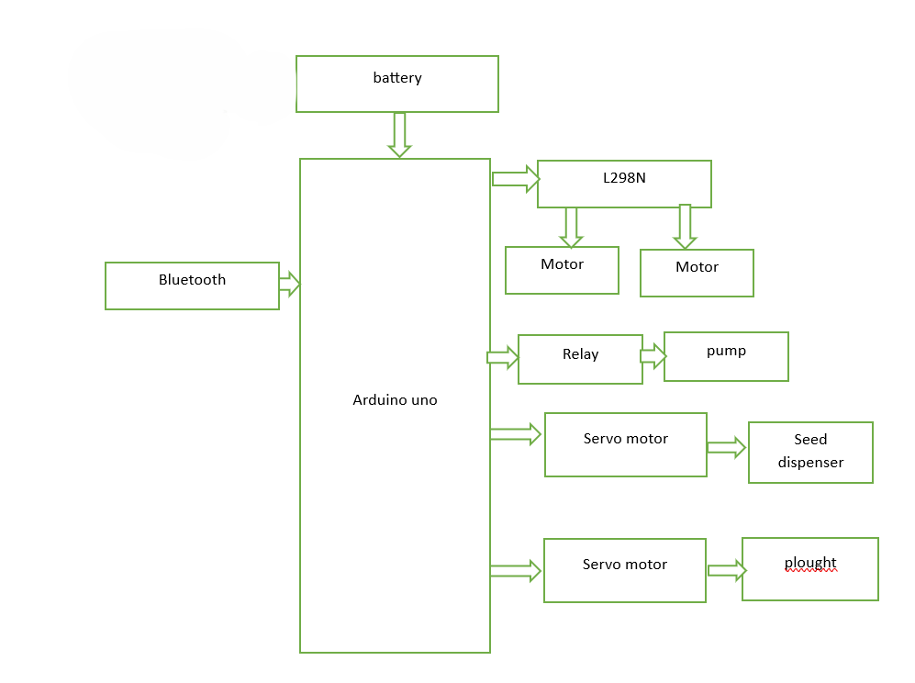
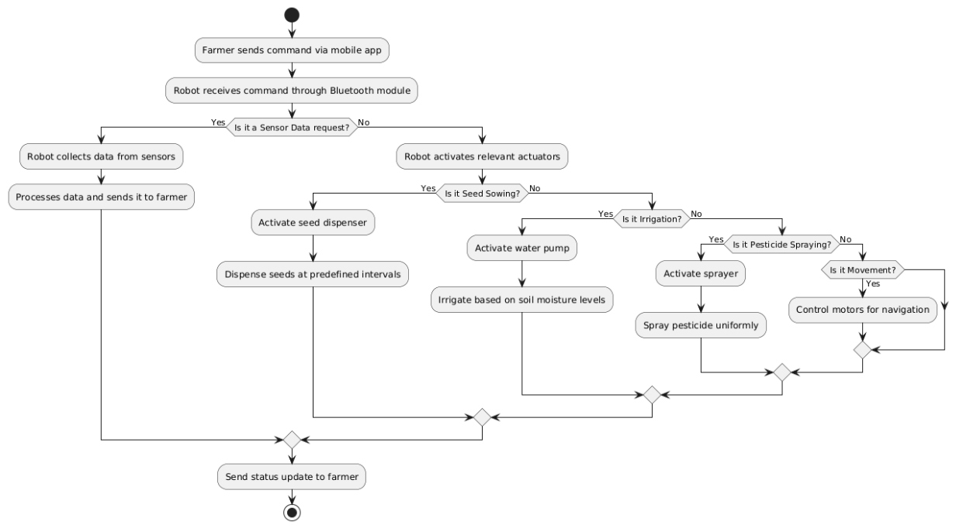
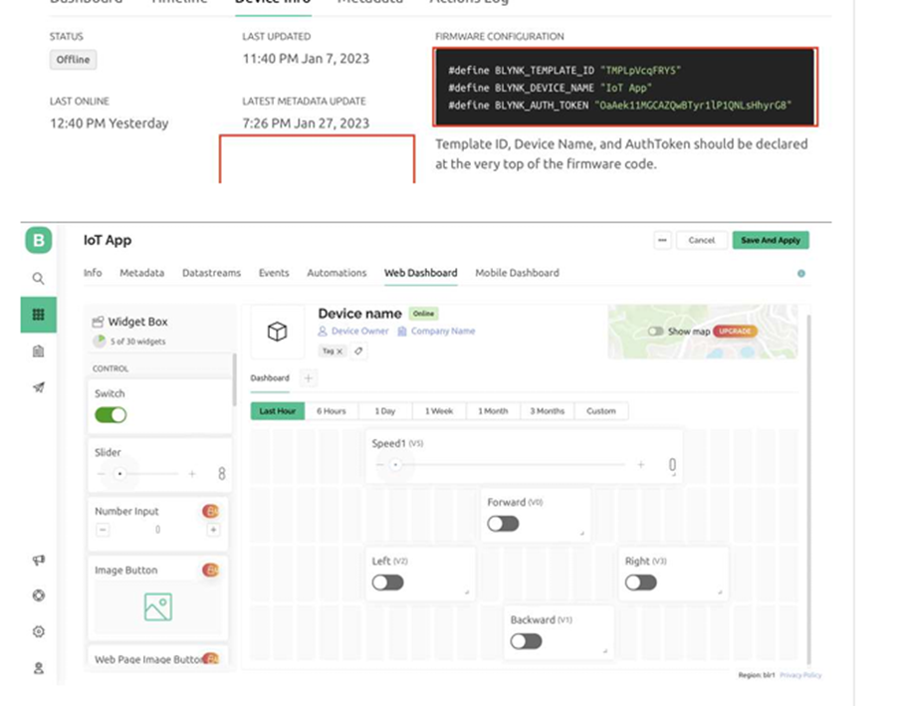
AGRIBOT: AN INTELLIGENT AUTONOMOUS SYSTEM FOR SMART AGRICULTURE
Guided By:D. Arpitha Rani
Assistant Professor
Abstract:
In the evolving landscape of Smart Agriculture, robotics has emerged as a key enabler for addressing critical challenges such as labour shortages, climatic uncertainties, and the need for increased agricultural productivity. The transition from manual labour to automation is driven by the demand for time-efficient, energy-saving, and scalable solutions to meet the needs of modern farming. Robotic systems not only enhance efficiency but also minimize repetitive labour-intensive tasks, ensuring consistent and precise agricultural operations. These advancements contribute significantly to improving crop yield, aligning with the goals of sustainable farming and food security.
A fundamental aspect of successful crop production is the automation of essential farming processes, which directly impacts yield, efficiency, and sustainability. Precision in seed placement, irrigation, pesticide spraying, ploughing, digging is crucial for optimizing plant growth, conserving resources, and improving productivity.
Implementation:
Architecture
Architecture
Introduction:
Agriculture plays a crucial role in sustaining human life, yet it faces numerous challenges such as labor shortages, unpredictable climatic conditions, and the need for enhanced productivity. Traditional farming methods heavily rely on manual labor, which is not only time-consuming but also prone to inefficiencies. As global food demand rises, there is an urgent need to adopt innovative solutions that can improve farming efficiency while reducing human effort. Robotics and automation have emerged as powerful technologies to address these challenges by streamlining agricultural operations and ensuring precision in farming practice
Conclusion:
The Solar-Powered Agriculture Robot presents a sustainable and technologically advanced solution to modern farming challenges. By automating tasks like watering, seed sowing, and ploughing, it significantly reduces human effort and enhances agricultural productivity. The integration of solar power minimizes operational costs and promotes eco-friendly practices. Mobile control via Bluetooth makes the system flexible and user-friendly, enabling efficient farm management. This innovative approach to agriculture holds the potential to transform traditional farming practices, leading to higher yields and sustainable farming methods.
Results:
Future Scope
The future scope of the "AGRIBOT: AN INTELLIGENT AUTONOMOUS SYSTEM FOR SMART AGRICULTURE" is rich with possibilities for expanding its capabilities and impact.
Reference
Acknowledgement
Project Team : Batch 18
2111CS050110 – R. Sai Deepak Goud 2111CS050096 – S. Srinath
2111CS050076 – V. Ganga Manikanta Reddy
MRUH
DEPARTMENT OF IoT
[1] ]. Rai, H.M., Gupta, D., Mishra, S. and Sharma, H., 2021, August. Agri-Bot: IoT Based Unmanned Smart Vehicle for Multiple Agriculture Operations. In 2021 International Conference on Simulation, Automation & Smart Manufacturing (SASM) (pp. 1-6). IEEE.

